Slide 1
Relationship Mapping
Or how to be really lazy in the classroom and help those kids be really creative

Slide 2
The Problems I Want to Address
Creativity in the classroom is difficult for many to teach.
Student ownership of their work is important for creative work to thrive.
Students who are not academically inclined tend can be tricked into getting excited about ideas
Depth of work is difficult to get from unegaged students.

Slide 3
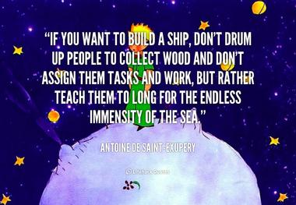

Slide 4
Problem: “Those” kids
Pretty constantly got “those kids” in my Acting Class
“They're a problem in other classes but we think they'll do well in yours.”
And---they weren't wrong. But certain things became difficult in class.
Luckily, I have an improv background

Slide 5
These are my babies
Founder of Illinois State University's
The most decorated improv troupe in the College Improv Tournament
#notahumblebrag #sorrynotsorry

Slide 6
Improv as Character Work
Short form vs. Long form
Improv can be used to create really interesting, fleshed out characters
BUT
You have to know how

Slide 7
Question: How do I get kids who don't care to create strong characters?
Solution:
The same kind of ways you have people who tell crappy stories to create strong characters.
Storytelling as a child
Which included:

Slide 8
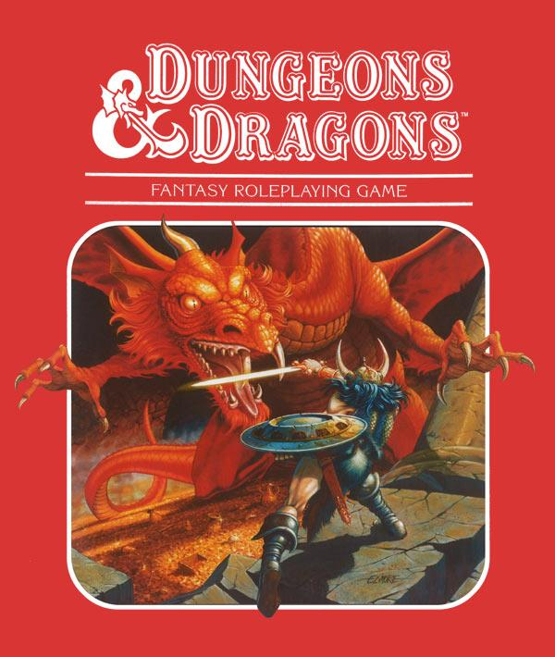
#GEEKALERT

Slide 9
Storytelling potential
Generally: Not good
Until they started to change
Heavy improvisational theatre influence

Slide 10
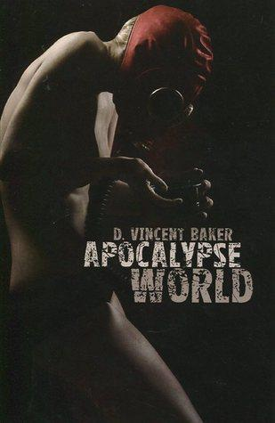
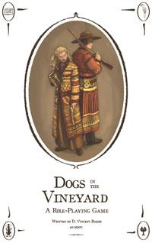
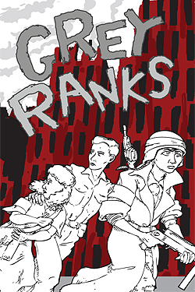
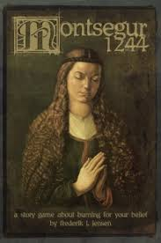
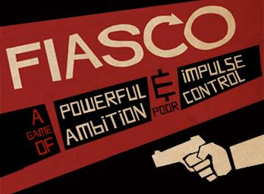
Story Heavy Games

Slide 11
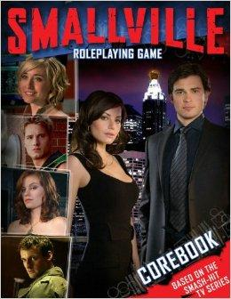
Inspiration from an odd place

Slide 12
What These Had to Do
Story Matters
Characters Matter
How do you make bad storytellers tell good stories?
How do you teach them what makes good characters and make it fun?

Slide 13
Problem Solving
Stories are hard
Writer's asked "Where do you get your ideas?"
Maybe you shouldn't be a writer.
Or maybe I have the tools to mine ideas.

Slide 14
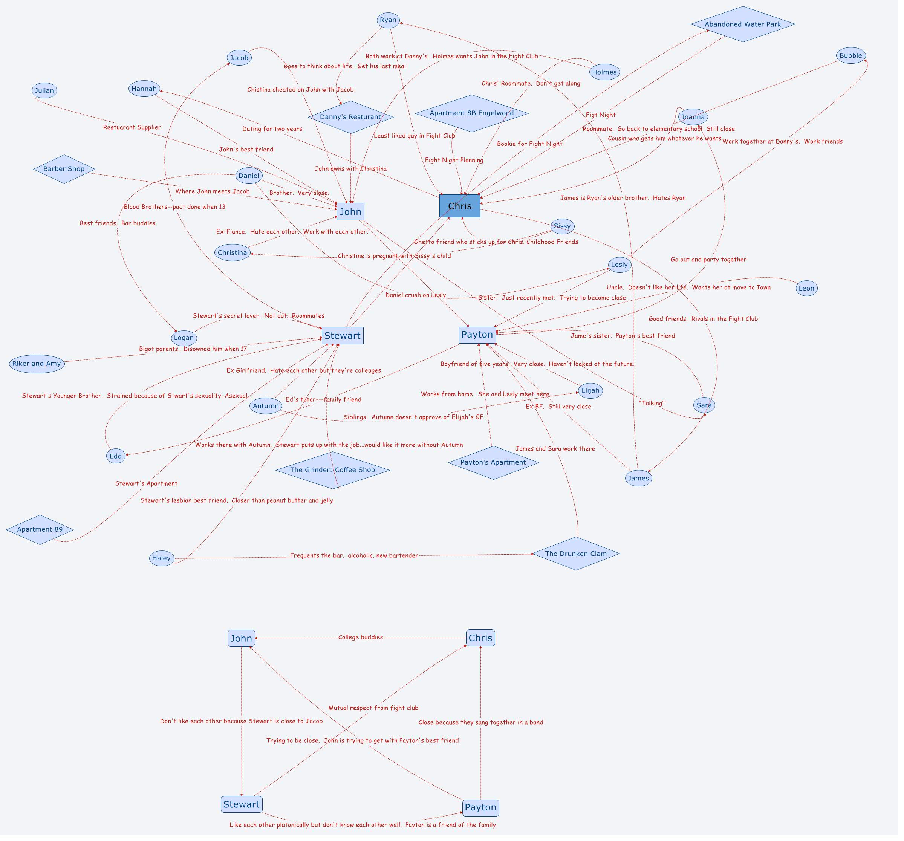

Slide 15
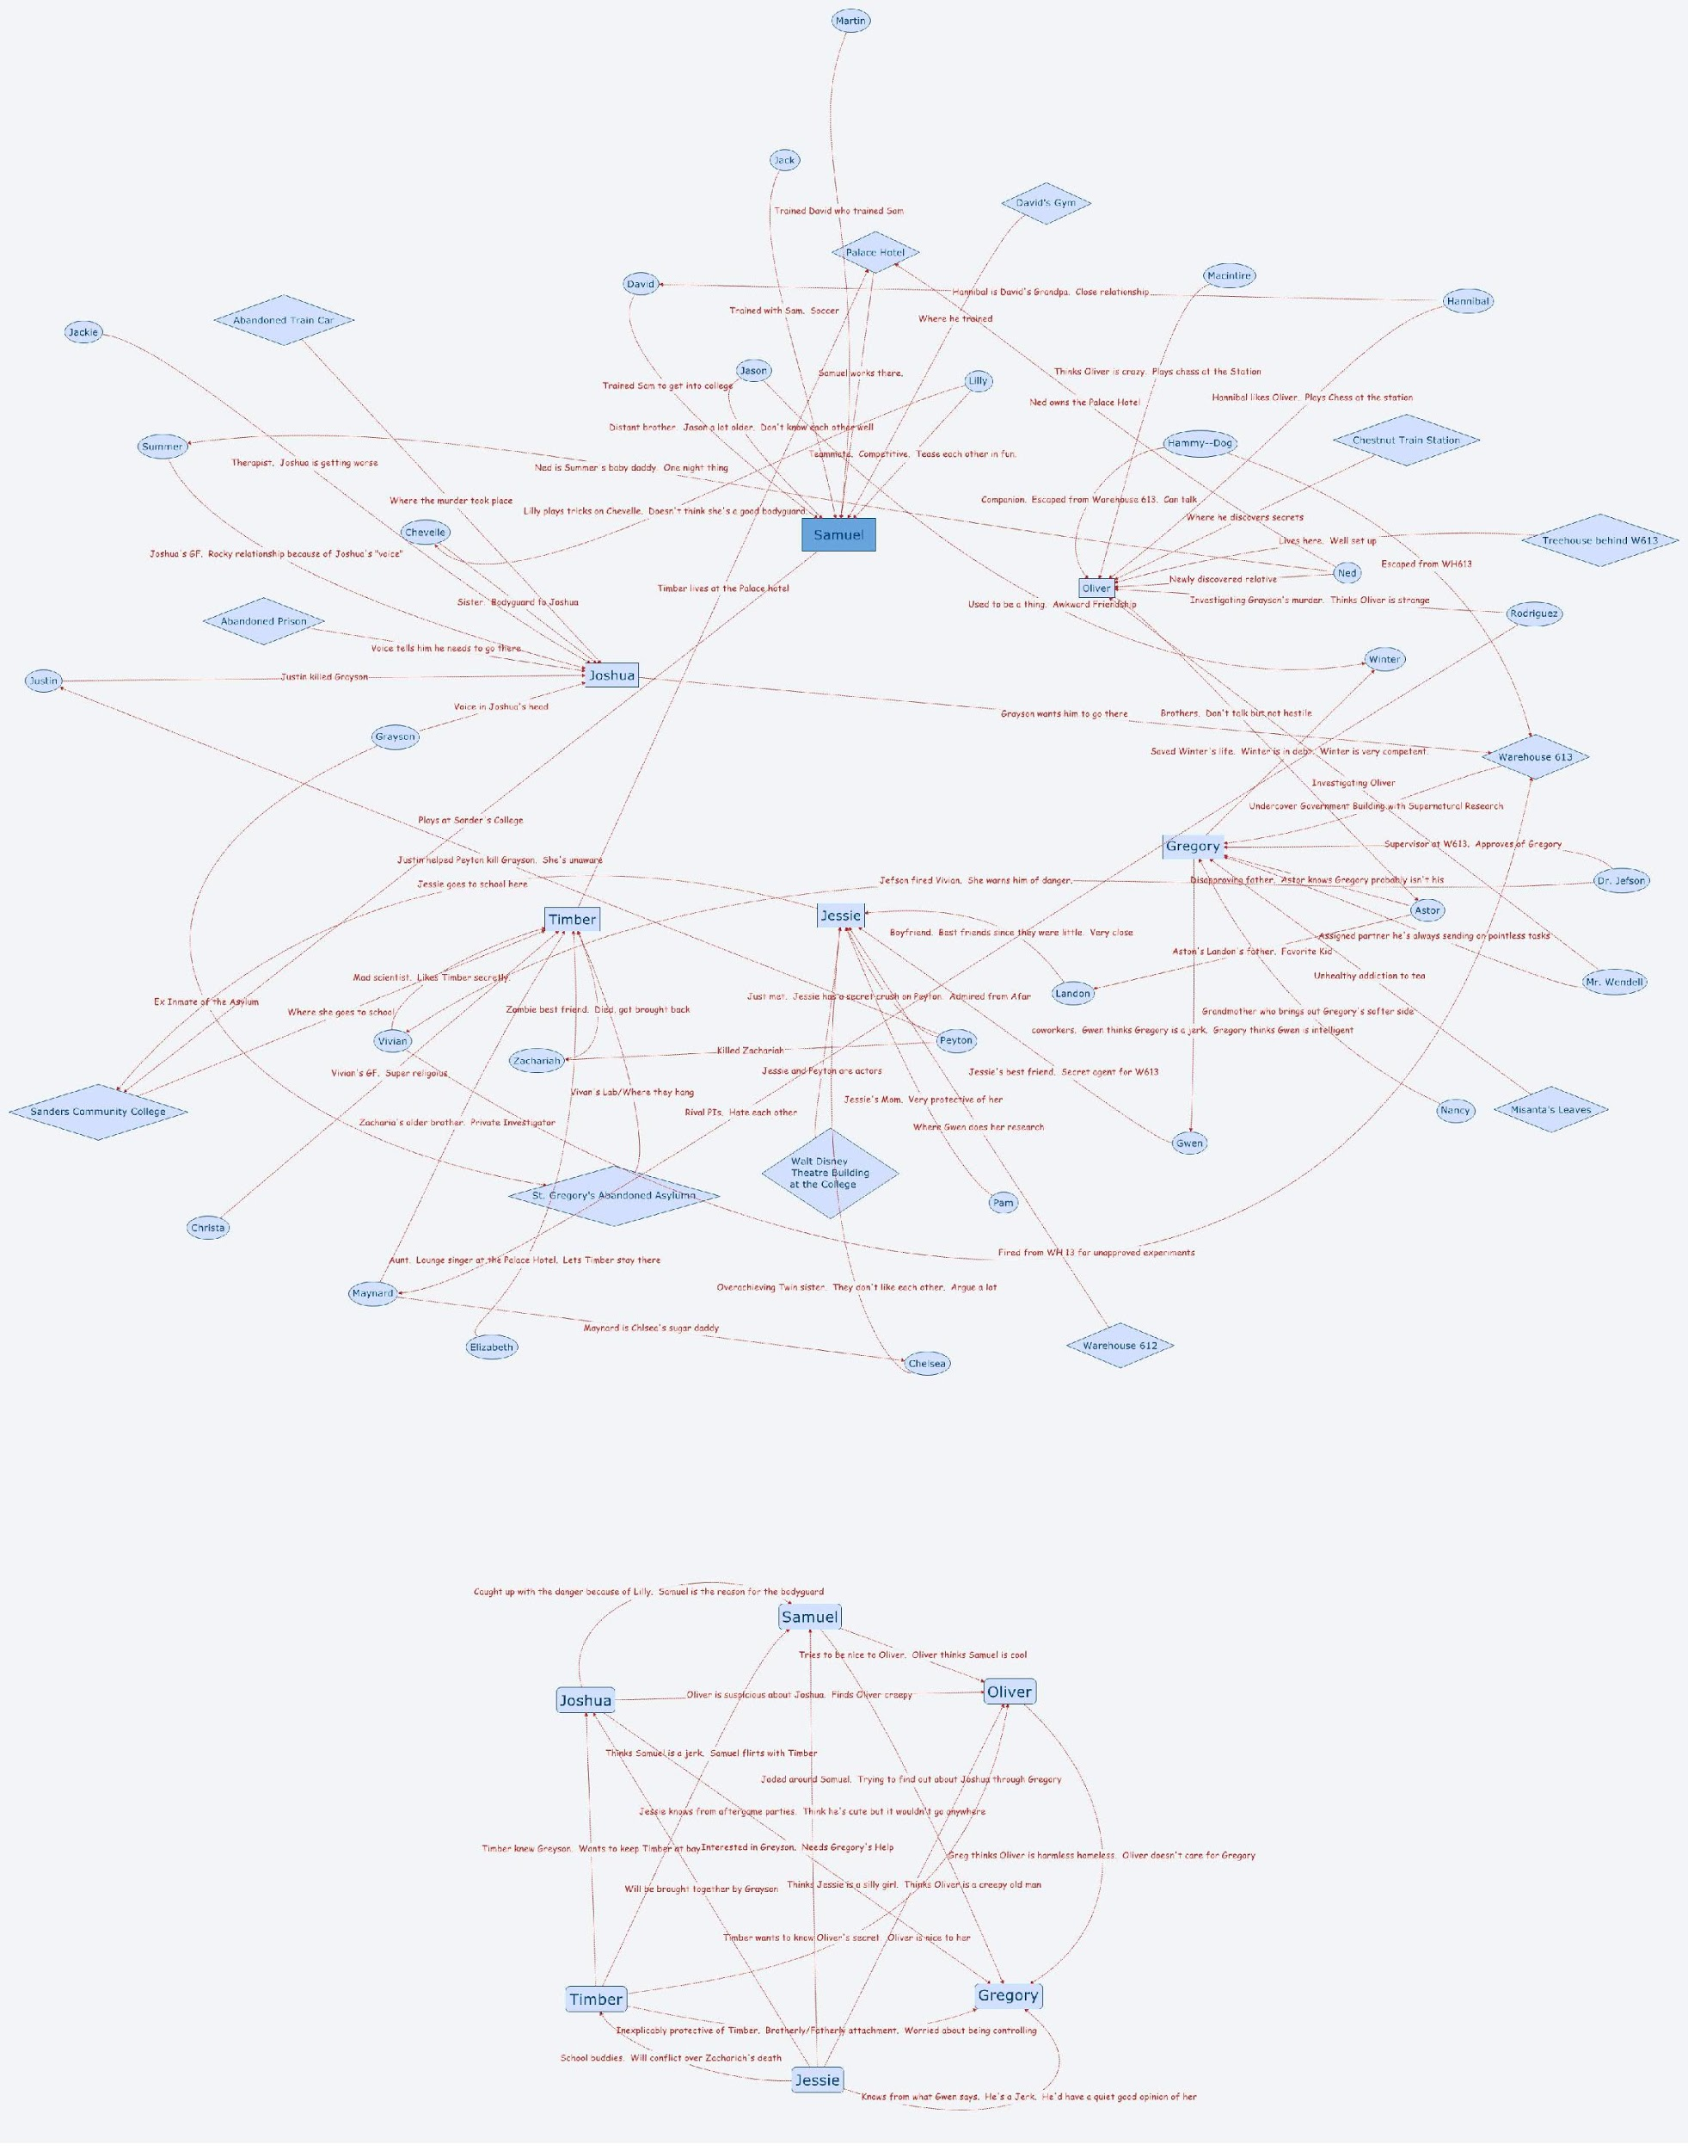

Slide 16
Benefits of the Relationship Map
Kills Analysis Paralysis
Creates joint ownership in the characters and story by the students
Models in depth character background in small steps
Needs little to no intervention by the teacher
Teacher as questioner not guide

Slide 17
Quotes the Justify My Activity
“By engaging in this collective purpose of production, we supported and taught each other how to use various production tools, re-mixed and traded practices, and even circulated each other's early designs for consideration.” (Lee, 56)
“..all learning comes from making connections among observations and ideas.” (Moore, 36)
“Since truth is in the details, seekers of truth should look for it there.” (Moore, 22)
“Interesting things happen when students find their passion,” Routman tells us. “They read and write voraciously about the subject that has captured their attention: They stop asking about length requirements; they stay engaged for long periods of time; their handwriting improves; writing becomes their favorite subjects” (296) (Moore, 82)

Slide 18
"Improvised performances thrive on making con- nections. Actors continually perceive associations and reincorporate elements into scenes. The actor must, “...store the information in the back of his mind, not relying on it too heavily, but keeping it handy so he can pull it out when something in the scene triggers the connection..." (Stamatopolos, 66)
"Exploration begins with a set of strong ideas to build from, and can develop in any unknown direction." (Ronen, 48)

Slide 19
Example
Now I will do an example
It will wow you with the possibilities

Slide 20
Your Turn
Get in groups of 4
Take a Trevor paper
Use the butcher paper and create some characters

Slide 21
Tell Your Stories
We want to know what you did and the stories that are coming from it.

Slide 22
Bibliography
Moore, Kathleen Dean. Riverwalking: Reflections on Moving Water. New York: Lyons & Burford, 1995. Print.
Lee, Clifford. “Production-Centered Classrooms” Teaching in The Connected Classroom. Garcia, Antero, and Christina Cantrill. Teaching in The Connected Classroom. Cork: BookBaby, 2014. Print.
Stamatoplos, Anthony. "Improvisational Theatre as a Tool for Enhancing Cooperation in Academic Libraries." ACRL 14th National Conference. March 12-15th, 2009 (2009); 65-70. Print
Ronen, Asaf. Directing Improv: Show the way by getting out of the way. New York: YESand, 2005. Print.

Slide 23
Standards
RL.11-12.3 Analyze the impact of the author's choices regarding how to develop and relate elements of a story or drama.
W.11-12.3 Write narratives to develop real or imagined experiences using effective techniques, well-chosen details, and well-structured event sequences.
W.11-12.5 Develop and strengthen writing as needed by planning, revising, editing, re-writing, or trying an new approach...
SL.11-12.1 Initiate and participate effectively in a range of collaborative discussion
SL.11-12.3 Evaluate a speaker's point of view, reasoning, and use of evidence and rhetoric, assessing the stance, premises, links among ideas, word choices, points of emphasis, and tone used.
SL.11-12.4 Present information, findings, and supporting evidence, conveying a clear and distinct perspective...

Slide 24
Reflection
What surprised you about the process?
Are there ways to use this process in your own classes? (Including for existing texts)
What kinds of changes might you have to make for different grade/ability levels?

